Slide 1
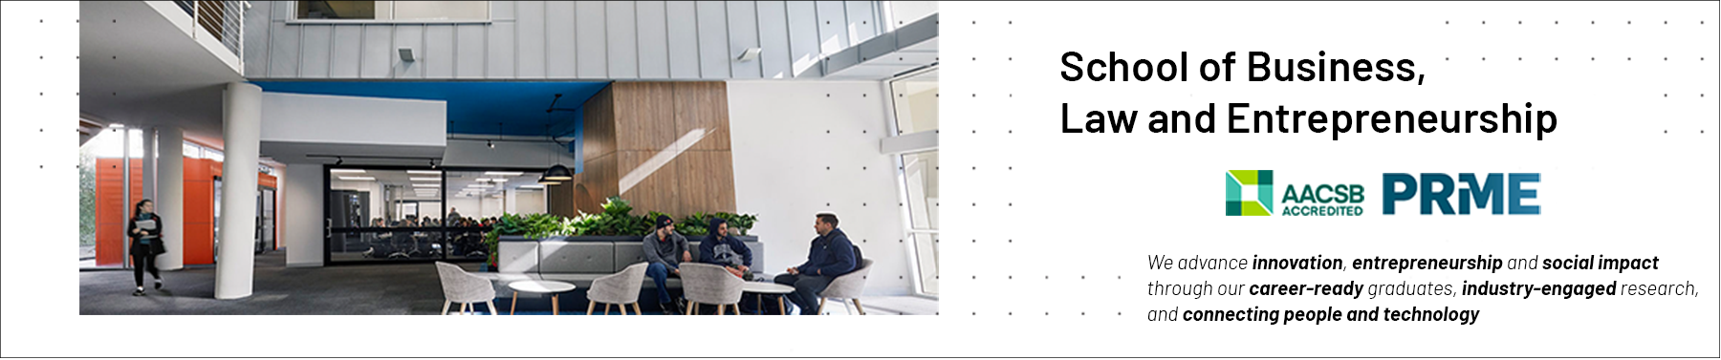

Teamwork as a Core Professional Competency Presentation 2: Group Development & Cohesion
Professional Capabilities for a Digital World

Slide 2
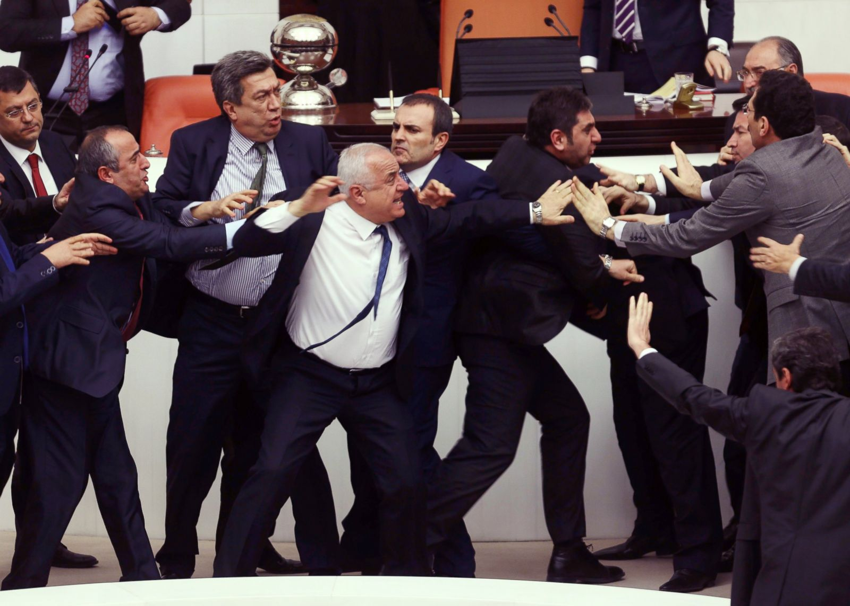
Why do we look at Group Dynamics?
Why do some groups fail and others succeed?
Why do some groups have great meetings with great attendance?
Why do some groups generate conflict and others collaboration?
Why does this happen a lot in Uni assignment groups?
Notes:
The basic unit of work in an organisation is a group
You will work in groups in different areas of your life all the time
Understanding how and why things happen in groups is important

Slide 3
Tuckman’s Theory of Group Development: How do Groups Develop?
FORMING (Orientation)
Group members get to know each other, uncertainty
STORMING (Conflict)
Period of conflict, characterised by disagreement
NORMING (Structure)
Group settles conflict, agrees on roles, standards and procedures
PERFORMING (Performance)
Focus on group work, task completion, cooperation (cohesiveness)
ADJOURNING (Dissolution)
End of group, departures, reaches goals
Notes:
Groups do not suddenly just appear and start doing things. Groups go through stages in their life-cycle, they develop over time. A group does not instantly become unified, cohesive. A group must develop; it grows before it can start producing beneficial outputs. So a group must become structured before we see outputs, roles must be assigned and so on. A group will function very differently on its first meeting as opposed to its third or fourth meeting.
Perhaps the best-know theory in group development is Tuckman’s theory of group development where he theorised that groups move through distinct stages in their development. Tuckman’s theory of group development is relatively old – published in 1965 – but it is still very dominant in group development theory – because is such a good theory – because it explains group development so well.
Cohesiveness defines the degree of closeness that the members feel with the group. It is one of the most important determinants of group performance. Greater commitment to the group, more alignment between individual objectives and group objectives would lead to better group performance.
The consequences of greater cohesiveness are more participation, more conformity, high productivity, more success, more influence, more communication and more personal satisfaction. A cohesive, developed group brings benefits
Group Development is a dynamic process. How do groups evolve? There is a process of five stages through which groups pass through. The process includes the five stages: forming, storming, forming, performing, and adjourning.
Forming:
The first stage in the life of a group is concerned with forming a group. This stage is characterized by members seeking either a work assignment (in a formal group) or other benefit, like status, affiliation, power, etc. (in an informal group). Members at this stage either engage in busy type of activity or show apathy.
Storming:
The next stage in this group is marked by the formation of dyads and triads. Members seek out familiar or similar individuals and begin a deeper sharing of self. Continued attention to the subgroup creates a differentiation in the group and tensions across the dyads / triads may appear. Pairing is a common phenomenon. There will be conflict about controlling the group.
Norming:
The third stage of group development is marked by a more serious concern about task performance. The dyads/triads begin to open up and seek out other members in the group. Efforts are made to establish various norms for task performance.
Members begin to take greater responsibility for their own group and relationship while the authority figure becomes relaxed. Once this stage is complete, a clear picture will emerge about hierarchy of leadership. The norming stage is over with the solidification of the group structure and a sense of group identity and camaraderie.
Performing:
This is a stage of a fully functional group where members see themselves as a group and get involved in the task. Each person makes a contribution and the authority figure is also seen as a part of the group. Group norms are followed and collective pressure is exerted to ensure the Process of Group effectiveness of the group.
The group may redefine its goals Development in the light of information from the outside environment and show an autonomous will to pursue those goals. The long-term viability of the group is established and nurtured. clip_image002
Adjourning:
In the case of temporary groups, like project team, task force, or any other such group, which have a limited task at hand, also have a fifth stage, This is known as adjourning.
The group decides to disband. Some members may feel happy over the performance, and some may be unhappy over the stoppage of meeting with group members. Adjourning may also be referred to as mourning, i.e. mourning the adjournment of the group.
The readers must note that the four stages of group development mentioned above for permanent groups are merely suggestive. In reality, several stages may go on simultaneously.

Slide 4
So how do groups become more cohesive?
 | Forming | Storming | Norming | Performing
Key tasks | • Establish base level expectations • Identify similarities • Agreeing on common goals | Identifying power and control issues • Gaining skills in communication • Identifying resources | Members agree about roles and processes for problem solving | Achieve effective and satisfying results • Members find solutions to problems using appropriate controls
Usual Behaviours | Making contact and bonding • Developing trust • Members dependent | Expressing differences of ideas, feelings, and opinions • Reacting to leadership • Members independent or counter dependent | Decisions are made through negotiation and consensus building | Members work collaboratively • Members care about each other • The group establishes a unique identity • Members are interdependent
Notes:
\

Slide 5

What does cohesion do for a group?
NEGATIVES
POSITIVES
Enhanced member satisfaction
Reduced stress/tension.
Higher group engagement
Reduced turnover
Longer duration of membership
Intense social and emotional processes
Increased influences, pressure
Hostility
Groupthink
Notes:
Group Cohesion and Development – Consequences of cohesion
What does cohesion do for a group? Generally speaking we regard cohesive groups more positively than less cohesive groups.
But this is not always the case. Cohesive groups are usually intense groups – very focused groups and this can impact negatively – on group members – on group dynamics.
So let’s look at the positives and the negatives.
From a positive perspective,
People enjoy being in cohesive groups – it’s not just task completion that gives satisfaction it is but also the quality of relationships.
Reduced stress in that a unified group with common goals people will feel that they belong. Feel positive and that is bound to decrease overall level of stress. Cohesive groups have higher levels of group engagement and rarely lose their members.
From a negative perspective,
Cohesive groups tend to intensify the emotional and social pressures on individual members.
Pressure to conform is greater. In extreme cases where a group member disagrees the pressure that can be brought to bear on that person can be quite strong – and this can lead to groupthink – which is a deterioration of the quality of decision-making – individual members feel they cannot disagree with the group.
So what is the relationship between cohesiveness and group productivity?
Generally speaking there is a high correlation between high productivity and group cohesion. A group that is cohesive around task and relationship will experience high productivity. And this is self-reinforcing – when a group succeeds it becomes more cohesive. Success makes a group cohesive.
Finally, a very important moderator of this relationship between group cohesiveness and performance is that of the groups norms. Groups with norms that stress a high work rate – we want to get things done – we want to be productive – we want to achieve, will be the most productive. Groups norms that do not support hard work will be strikingly unproductive.
I am sure you can all reference this from your own experience in groups..

Slide 6


Slide 7
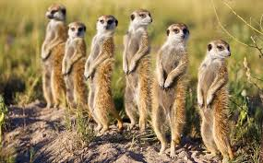
Bales Equilibrium Model
CYCLICAL MODEL
Bales Equilibrium model
Task focused
Relationship focused
Task Focused
Relationship Focused
Notes:
\

